Slide 1
Introduction of Structured Computer Programming with C
Md. Alamgir Hossain
Senior Lecturer
Dept. of CSE, Prime University
Mail: alamgir.cse14.just@gmail.com

Slide 2

C Programming Language
C is a general-purpose programming language that is extremely popular, simple, and flexible to use.
It is a structured programming language that is machine-independent and extensively used to write various applications, Operating Systems like Windows, and many other complex programs like Oracle database, Git, Python interpreter, and more.
C is a base for programming. If you know ‘C,’ you can easily grasp the knowledge of the other programming languages that use the concept of ‘C’.
In 1972, great computer scientist Dennis Ritchie created a new programming language called ‘C’ at the Bell Laboratories. It was created from ‘ALGOL (1960)’, ‘BCPL (1967)’, and ‘B (1970)’ programming languages.

Slide 3
Key Applications
‘C’ language is widely used in embedded systems.
It is used for developing system applications.
It is widely used for developing desktop applications.
Most of the applications by Adobe are developed using ‘C’ programming language.
It is used for developing browsers and their extensions. Google’s Chromium is built using ‘C’ programming language.
It is used to develop databases. MySQL is the most popular database software which is built using ‘C’.
It is used in developing an operating system. Operating systems such as Apple’s OS X, Microsoft’s Windows, and Symbian are developed using ‘C’ language. It is used for developing desktop as well as mobile phone’s operating system.
It is used for compiler production.
It is widely used in IOT applications.

Slide 4
Structured Programming Language
For solving a large problem, C programming language divides the problem into smaller structural blocks or modules each of which handles a particular responsibility.
Example:
A Program
Addition | Subtraction | Multiplication | Division
One
Module
A program
Addition
Subtraction
Multiplication
Division
Different
Module

Slide 5

Some important advantages of C programming
C is a Middle-Level Language. The middle-level languages are somewhere between the Low-level machine understandable assembly languages and High-Level user friendly languages.
It can be used for writing operating systems as well as doing application level programming.
Helps to understand the fundamentals of Computer Theories. Most of the theories related to computers like Computer Networks, Compiler Designing, Computer Architecture, Operating Systems are based on C programming language.
In the modern high level languages, the machine level details are hidden from the user, so in order to work with CPU cache, memory, network adapters, learning C programming is a must.

Slide 6
Some important advantages of C programming
Fewer Libraries. C programming language has fewer libraries in comparison with other high-level languages.
So, learning C programming also clears programming concepts to a great extent as you have to write lot of things from scratch.
C is very fast in terms of execution time. Programs written and compiled in C executes much faster than compared to any other programming language. The programmer must take care of these things on his own.

Slide 7
Some important advantages of C programming
Embedded Programming. C is extensively used in Embedded Programming.
Embedded Programming is also referred to as micro-controller programming, where C program is used to control micro-controllers.
Microcontrollers and embedded programming is widely used in auto-motives, Robotics, Hardwares etc.

Slide 8
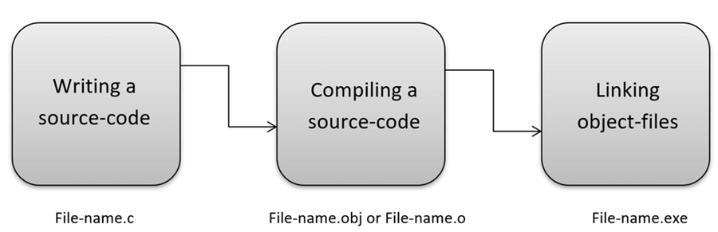
How C Programming Language Works?

Slide 9
List of Popular Compilers Available Online
Clang compiler
MinGW compiler (Minimalist GNU for Windows)
Portable ‘C’ compiler
Turbo C, etc.
We will use an open-source Integrated Development environment named Code::Blocks which bundles a compiler (named GCC(GNU Compiler Collection) offered by Free Software Foundation GNU), editor and debugger in a neat package.

Slide 10
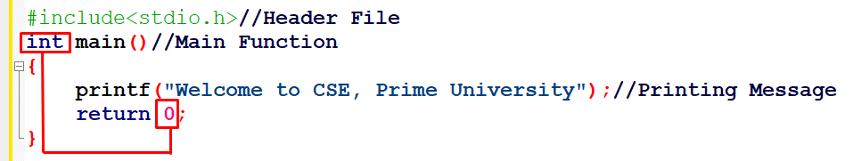
First C program

Slide 11
Which part is used for why??
#include <stdio.h> includes the standard input output library functions. The printf() function is defined in stdio.h.
int main(); The main() function is the entry point of every program in C language.
printf(); The printf() function is used to print data on the console.
return 0; The return 0 statement, returns execution status to the OS. The 0 value is used for successful execution and 1 for unsuccessful execution.

Slide 12
printf() and scanf() in C
The printf() and scanf() functions are used for input and output in C language. Both functions are inbuilt library functions, defined in stdio.h (header file).
The printf() function is used for output. It prints the given statement to the console.
The syntax of printf() function is: printf(“format string”, argument_list);
The format string can be %d (integer), %c (character), %s (string), %f (float) etc.
The scanf() function is used for input. It reads the input data from the console.
The syntax of scanf() function is: scanf(“format string” , argument_list);

Slide 13
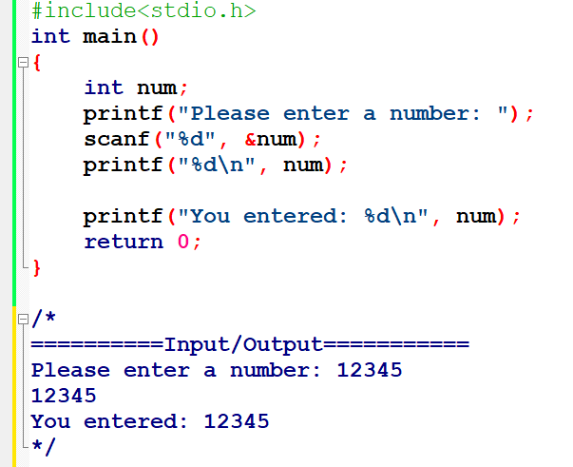
Example using printf() and scanf() in C

Slide 14
Thank You

